Slide 1
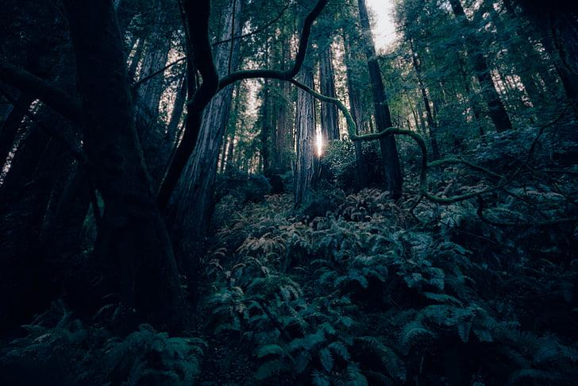
Hello! My name is Maya Bhatt, and I am the graphic designer of this project. I help with the background, the font, the pictures, and fixing any problems that show on the website for anything. This website has three mythical creatures: the elf, the pixie, and the dragon. I have a team of four, and we worked together on this website, each of us with different roles and expectations.
The Magical Forest
By Maya Bhatt 13 June 2026 | Orange Belt Final Project Presentation
Confidential
Notes:
Hi everyone! I'm Maya Bhatt, and I was the lead graphic designer (as well as front-end architect along with Aiden) for our team's project, The Magical Forest

Slide 2
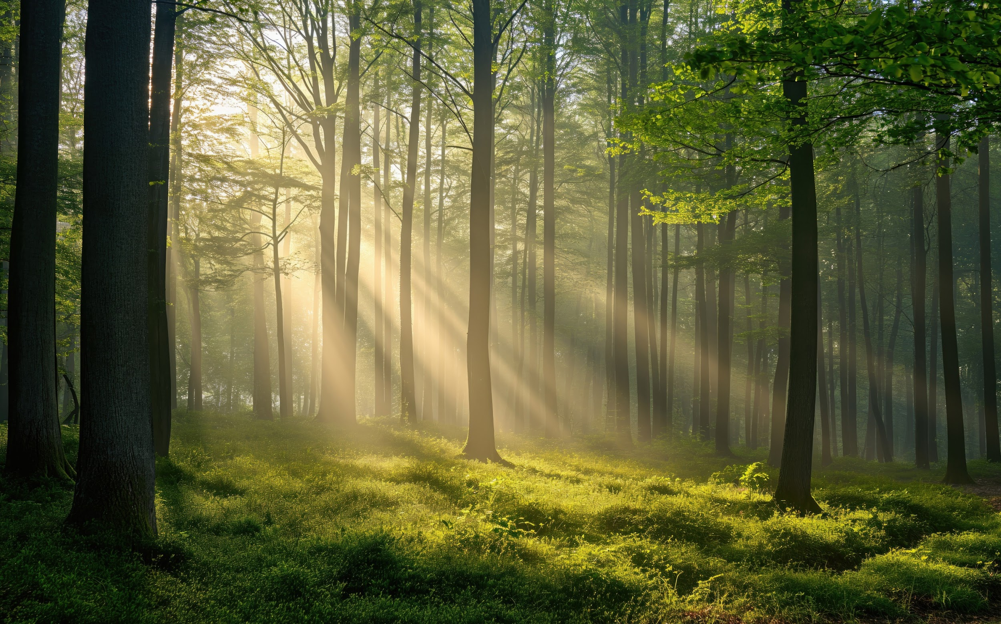
What Did We Build?
A quick tour of the whole thing
A multi-page, fantasy-themed website called The Magical Forest 🌲
Inspired by the look and feel of Lord of the Rings
Visitors explore three magical creatures: Dragon 🐉, Elf 🧝, and Pixie 🧚
Each creature has its own Gallery page, Lore page, and a Mini-Game
It's all live on the internet using GitHub Pages: anyone can visit it!
🔗 icode-dev-col.github.io/Orange-Belt-Final-Project
Notes:
So, what exactly is The Magical Forest? It's a multi-page fantasy website - think Lord of the Rings vibes. You can explore three mythical creatures: a Dragon, an Elf, and a Pixie. Each one has its own gallery, lore page, and a mini-game! And the coolest part? It's actually live on the internet - anyone in the world can visit it right now at that link. We deployed it using something called GitHub Pages, which I'll talk about in a bit.

Slide 3







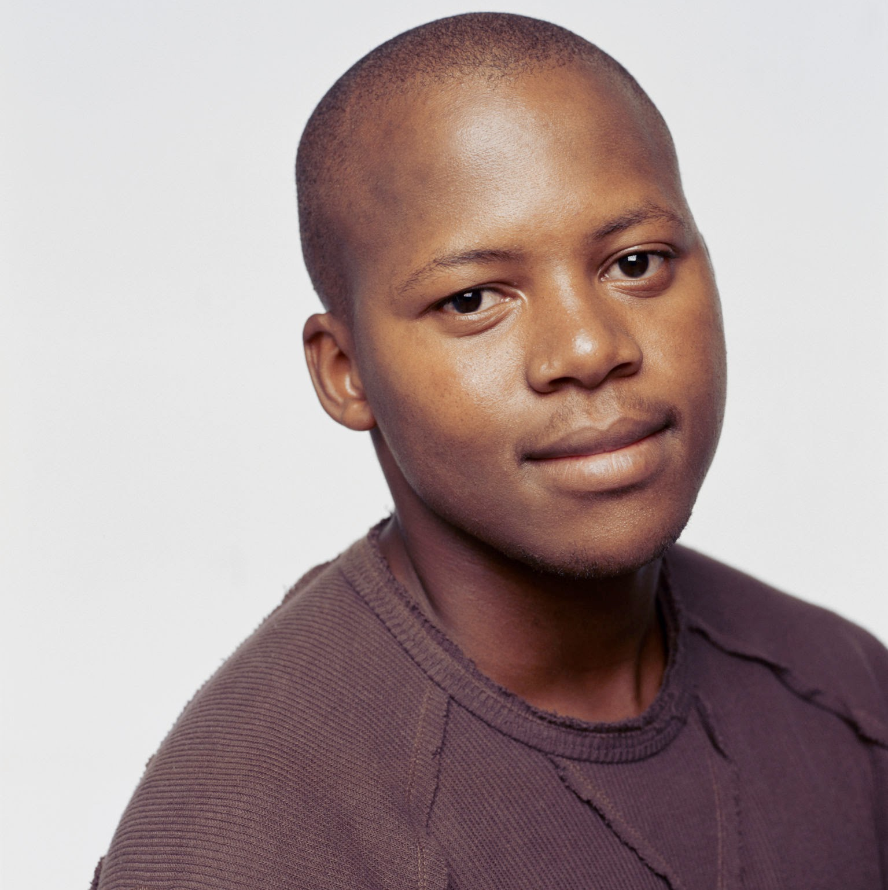
Meet the team
THE DRAGON
Dragons are mythical creatures that are very unique. They have scales that can be any design, they have a very large wingspan, and they show extreme bravery and fighting skills.
Full Name
Full Name
Full Name
Full Name
Title
Title
Title
Title
Full Name
Full Name
Full Name
Full Name
Title
Title
Title
Title
Confidential

Slide 4
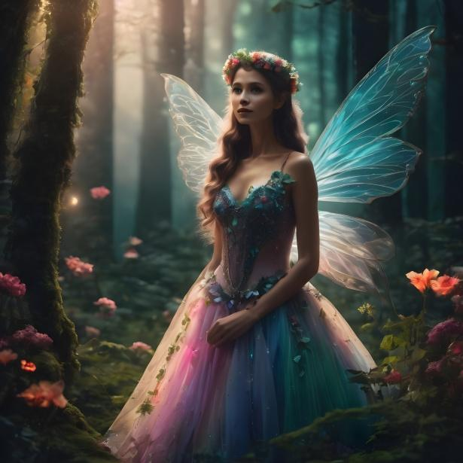
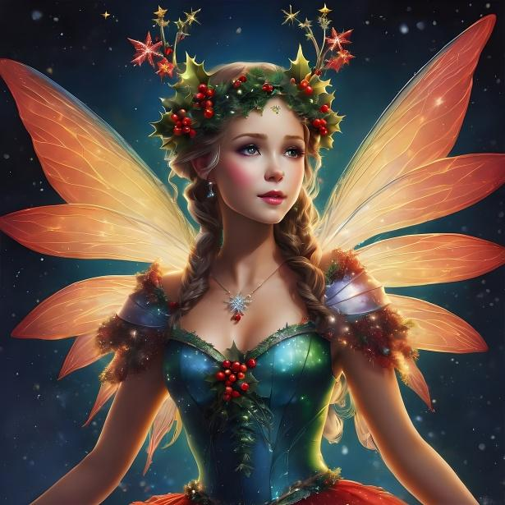
Meet the team
THE PIXIE
Full Name
Full Name
Title
Title
Write a brief bio of this team member. Mention their background, area of expertise, and what their responsibilities will be on this project.
Write a brief bio of this team member. Mention their background, area of expertise, and what their responsibilities will be on this project.
Full Name
Full Name
Title
Title
Write a brief bio of this team member. Mention their background, area of expertise, and what their responsibilities will be on this project.
Write a brief bio of this team member. Mention their background, area of expertise, and what their responsibilities will be on this project.
Pixies are very magical creatures. They have beautiful wings that help them fly. They are very attractive and very beautiful. They sometimes have magical pixie dust to do spells and other things. They usually hide out in the deep parts of the forest. They also wear very pretty and designed dresses.
Confidential

Slide 5
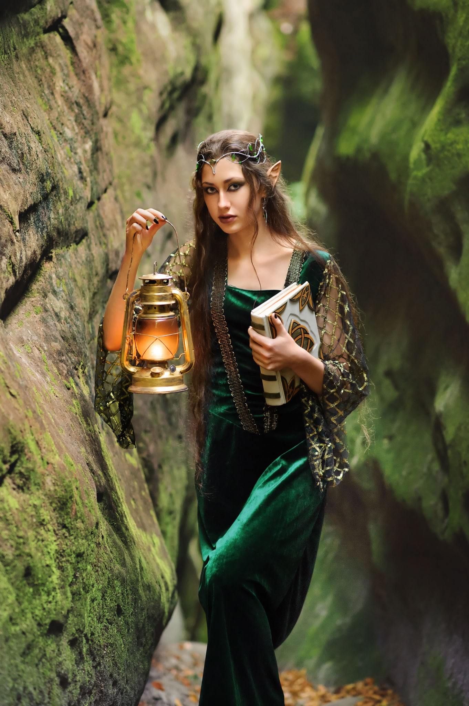
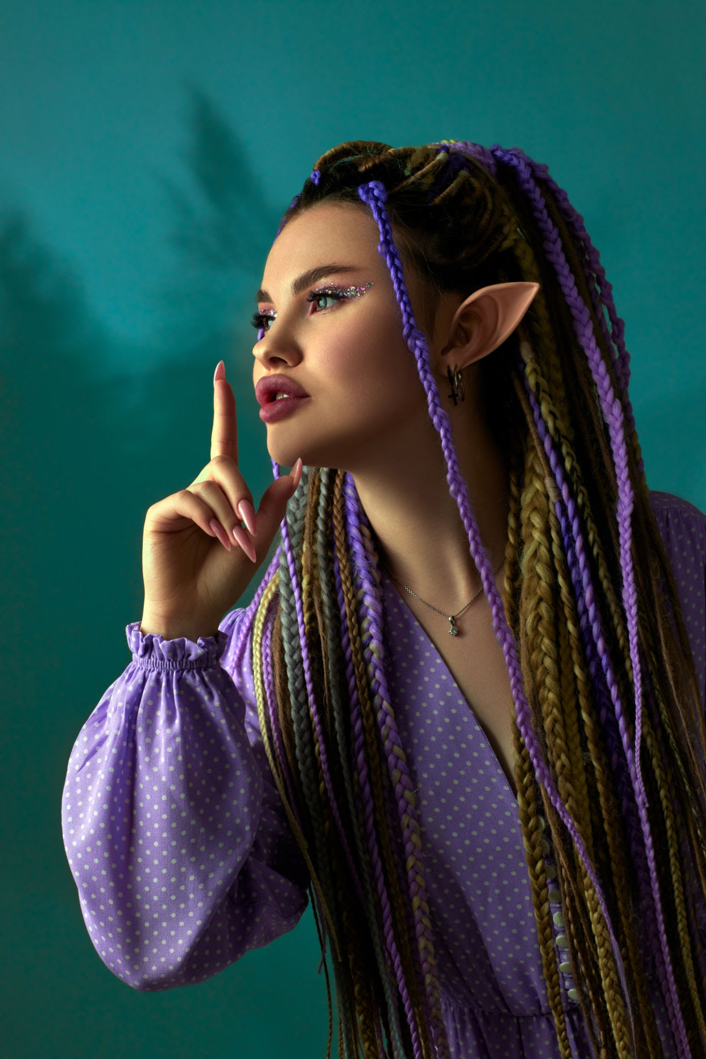
Write a brief, inspiring summary of the campaign. Get your audience excited about it. For now, focus on the big picture. You can dive into more detail later.
THE ELF
CAMPAIGN OVERVIEW
Elves are also very unique. They can be boys or girls. They have very pointy ears, which is a unique part of them that most mythical creatures don’t have. They sometimes wear special headbands and wear special clothing. They hang out in deep parts of the forest and carry lanterns with them.
Confidential

Slide 6
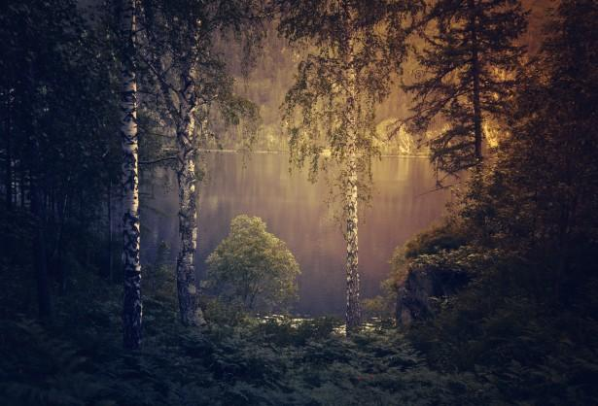
Section 01
TECH STACK
Notes:
Okay, let's get into the technical stuff - starting with what tools we actually used to build this.

Slide 7
The Three Tools We Used
Every website on Earth uses these three things
HTML5
CSS3
JavaScript
The skeleton 🦴
Sets up every page,
headings, links,
buttons & images.
The clothes 👗
Colors, animations,
layout, fancy
glass effects!
The brain 🧠
Makes things move,
tracks scores &
plays sounds.
Notes:
Every single website you've ever visited was built using these three things: HTML, CSS, and JavaScript. I like to think of them this way… HTML is the skeleton, it sets up all the structure. CSS is the clothes, it makes everything look good. And JavaScript is the brain, it makes things actually do stuff. We used all three together throughout this whole project.

Slide 8
GitHub & GitHub Pages
How we saved our work and put it on the internet
GitHub is like Google Docs but for code
Every time we saved a new version it's called a commit
122 commits in this project: that's a LOT of saves!
Git tracks who changed what and when
GitHub Pages turns your code folder into a real website
It gives you a free URL (*.github.io)
No need to pay for a server: it's free!
Our site went live just by pushing code to the Test branch
Notes:
So how did we save our work and actually put the site on the internet? GitHub! Think of it like Google Docs - but for code. Every time we saved a new version, that's called a commit. We racked up 122 commits on this project, which is honestly a lot of saving! GitHub also lets you track who changed what and when, which is super useful when four people are working on the same files. And GitHub Pages - that's the magic feature that turns your code into a real website with a real URL, totally free.

Slide 9
Section 02
How We Organized Files
HOW WE ORGANIZED
FILES
Notes:
Next up - how we organized all our files. This might sound boring but trust me, getting this wrong makes everything fall apart.

Slide 10
Our File & Folder Layout
Think of it like rooms in a house
Orange-Belt-Final-Project/
├── index.html ← The front door (home page)
├── team.html ← Meet the team page
├── css/
│ └── style.css ← ALL our styling lives here
├── images/ ← dragon.png, elf.png, pixie.png, forest.png
├── dragon/
│ ├── index.html ← Dragon gallery
│ ├── info.html ← Dragon lore
│ └── game.html ← "Feed the Dragon" mini-game 🐉
├── elf/
│ ├── index.html / info.html / game.html ← Same pattern!
└── pixies/
├── index.html / info.html / game.html ← Same pattern!
Notes:
We have a lot of files in this project. To keep things sane, we organized everything like rooms in a house. The main index.html is like the front door. Then each creature - dragon, elf, pixie, gets its own folder. And inside each folder there's the same three pages: a gallery, a lore page, and a game. One CSS file handles all the styling across every single page. Having this structure meant when someone needed to find something, they actually could.

Slide 11
Relative Linking: Navigation Between Pages
How we travel from one page to another without breaking links
Absolute link: https://mysite.com/dragon/index.html - full address, always works
Relative link: ../index.html - means 'go up one folder, then open index.html'
We used relative links so the site works on ANY server - local or GitHub Pages
Example/game.html, to get back home we write href="../index.html: inside /dragon"
This is just like giving directions: 'go back out the dragon door, you're home!'
<a href="../index.html">🏠 Back to Forest Home</a>
Notes:
Okay this one tripped us up at first. When you link from one page to another, you have two options: an absolute link, the full URL, or a relative link, which is like giving directions from where you already are. We used relative links everywhere. So inside the dragon folder, to get back to the home page, we write ../index.html - that .. means 'go up one folder.' It's like saying 'back out the dragon door, now you're home.' The big reason to use relative links? The site works whether it's running on our laptop or on GitHub Pages. No rewriting links every time.

Slide 12
Section 03
CSS Magic ✨
Notes:
This is CSS. As the designer, this is where I lived for this project.

Slide 13
CSS Variables: One Color, Used Everywhere
:root {
--gold: #C9A84C; /* The shiny gold color */
--bg-dark: #0D1B0F; /* Deep forest black-green */
--text: #F5F0E8; /* Warm off-white for text */
}
/* Now use it anywhere! */
h2 { color: var(--gold); }
nav { background: var(--bg-dark); }
p { color: var(--text); }
Define once, use forever — like a nickname for a color
If we want to change the gold color, we only edit ONE line… not 50!
This is called a Design Token… real-world companies use this too
Notes:
CSS variables were honestly a game-changer for us. Instead of typing the same gold color hex code, #C9A84C, 50 times across 10 files, we defined it once at the top with a nickname. Then everywhere we needed that gold, we just write var(--gold). When we wanted to tweak the shade? We changed one line and it updated everywhere instantly. Real companies call this a Design Token - and now we know why they use it!

Slide 14
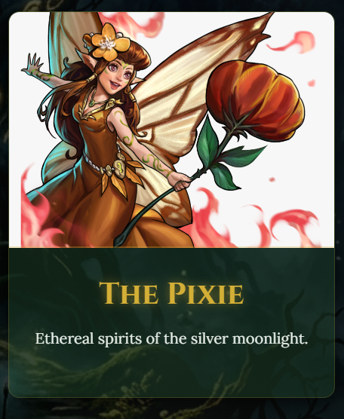
Glassmorphism: The Frosted Glass Effect
nav {
background: rgba(7, 14, 10, 0.6); /* semi-transparent bg */
backdrop-filter: blur(10px); /* ← THE magic line */
border-bottom: 1px solid rgba(201, 168, 76, 0.3);
}
That blurry see-through nav bar is all CSS!
rgba() = Red, Green, Blue, Alpha… the last number (0.6) controls how see-through
backdrop-filter: blur() blurs whatever is BEHIND the element
The forest background image shines right through the nav bar
This is a modern CSS feature - it didn't exist 5 years ago!
Notes:
You know that frosted glass effect on our nav bar where you can kind of see the forest through it? That's called glassmorphism, and it's all CSS. The key line is backdrop-filter: blur(10px) - that literally blurs whatever is behind the element. Then rgba() controls how see-through the background is. The last number in rgba is the alpha, which is basically the opacity - 0 is invisible, 1 is fully solid. Oh, and this is actually a pretty modern CSS feature… it didn't even exist like 5 years ago!

Slide 15
CSS Animations: Making Things Move
@keyframes float {
0% { transform: translateY(0px); opacity: 0.8; }
50% { transform: translateY(-20px); opacity: 1; }
100% { transform: translateY(0px); opacity: 0.8; }
}
.particle {
animation: float 3s ease-in-out infinite;
}
The floating fireflies and drifting forest mist are pure CSS
@keyframes defines the START and END of an animation (and any middle steps)
transform: translateY moves the element UP or DOWN in pixels
infinite means it loops forever - like real fireflies!
Each firefly gets a random animation-delay so they don't all move together
Notes:
The floating fireflies on our home page? Pure CSS, no JavaScript involved. We used @keyframes to define an animation - basically you're telling the browser 'start here, go here, come back.' translateY moves the element up and down in pixels. And infinite makes it loop forever. The coolest trick: we gave each firefly a different animation-delay, so they all float out of sync… just like real fireflies!

Slide 16
CSS Grid & Flexbox: Laying Out the Page
Two superpowers for arranging elements on screen
FLEXBOX - arranges items in a row or column
Perfect for nav bars and centering things
display: flex; justify-content: center;
Think of it like a conveyor belt that lines things up
GRID - arranges items in rows AND columns
Used for the creature card layout (3 across!)
display: grid; grid-template-columns: repeat(3, 1fr);
Think of it like a table - rows and columns
Notes:
These are the two big layout tools in CSS. Flexbox is great for lining things up in one direction - like our nav bar, or centering something on the page. Think of it like a conveyor belt. Grid is more powerful - it handles rows and columns at the same time. We used Grid for the creature card layout so all three cards line up perfectly across the page. We actually used both on the same site, because they solve different problems.

Slide 17
Section 04
JavaScript: Making It Alive 🧠
Notes:
Now JavaScript… this is where the site stops being a picture and starts being an experience.

Slide 18
Event Listeners:Listening for Clicks
JavaScript waits and watches — then reacts!
// Grab the button from the HTML
const enterBtn = document.getElementById('enter-btn');
// Listen for a click, then run a function
enterBtn.addEventListener('click', () => {
// Hide the dark overlay
enterOverlay.classList.add('hidden');
// Start playing forest music!
forestAudio.volume = 0.4;
forestAudio.play();
});
addEventListener('click', ...) means 'when clicked, do THIS'
We can listen for: click, mousemove, keydown, scroll, and more
The function inside is called a callback — it only runs when the event fires
Notes:
JavaScript works by listening and reacting. An event listener sits on an element and waits - 'did someone click this?' When they do, it runs a function. In our case, clicking the Enter button hides the overlay and starts playing the forest music. The function that runs when the event fires is called a callback. We can listen for all kinds of events; clicks, key presses, scrolling, mouse movement. It's JavaScript's way of making the page respond to the user.

Slide 19
Audio & The Autoplay Rule
Why websites can't just blast sound at you without permission
Browsers block audio from auto-playing - so random websites can't scare you
This is called the Autoplay Policy - it's a browser rule, not our bug!
To play audio, the user MUST click something first
Our solution: show a big 'Enter the Realm' overlay first
When they click that button, it satisfies the browser AND triggers the music
forestAudio.play() is called inside the click event listener
Notes:
So we wanted music to play when you open the site. Turns out: browsers block that by default. It's called the Autoplay Policy, and it's a real browser rule designed so random websites can't just blast sound at you. It's not a bug we made, it's intentional! The fix? You have to wait for the user to click something first. So we made the 'Enter the Realm' overlay… the user clicks it, that satisfies the browser's rule, and then we trigger forestAudio.play() right inside that click event. Two birds, one stone.

Slide 20
State Management: Keeping Score
Variables that remember what's happening in the game
let score = 0; // how many gems offered
let hits = 0; // how many times the dragon breathed fire
// When the player offers gold:
function offerGold() {
score++; // add 1 to score
scoreDisplay.innerText = score; // update the screen instantly
if (score >= 10) {
message.innerText = "The Dragon is pleased! 🐉";
}
}
Variables like score and hits are our game's 'memory'
innerText lets us update what the player sees on screen instantly
This is called State — the current situation of the game at any moment
Notes:
Games need memory. They need to know: what's the score? How many times has the dragon breathed fire? We store that in variables like score and hits. Every time the player does something, we update those variables and then update what shows on screen with innerText. This idea… the current snapshot of everything happening in your program, is called state. Even huge apps like Instagram are doing the same thing, just with way more variables.

Slide 21
Section 05
Conclusion🏆
Notes:
Alright, wrapping up!

Slide 22
Challenges We Faced
Being a developer means solving problems… here's what we ran into
🔇 Audio Autoplay blocked by browser
→ Fixed with the 'Enter the Realm' overlay trick
🔗 Broken links between sub-folders
→ Used relative paths ( ../ ) correctly
📱 Making it look good on all screen sizes
→ Used CSS Grid + Flexbox together
💎 Gems pile up and slow the browser
→ Used setTimeout to auto-remove old gems
🎨 Keeping colors the same across 10+ files
→ Used CSS Variables in :root
🤝 Working as a team on the same codebase
→ Used GitHub branches + commit messages
Notes:
Honestly, the challenges are where we learned the most. Audio getting blocked by the browser - fixed it with the overlay. Broken links between sub-folders - figured out relative paths. Making the site look good on phones and laptops - used Grid and Flexbox together. Gems in the game causing the browser to slow down - used setTimeout to delete old ones automatically. Colors getting inconsistent across 10 files - CSS variables saved us. And working as a team on the same code - GitHub branches kept us from overwriting each other's work.

Slide 23
What I Learned
How to design a multi-page site so all the pages feel connected
CSS Variables are super important, they saved us so much time
Glassmorphism and @keyframes animations make sites feel premium
Good folder structure makes teamwork SO much easier
Relative links are tricky but once you get them, they're powerful
Real developers use GitHub every day: now I know why!
Reading error messages is 50% of coding 😄
Notes:
So personally? I went from knowing basically nothing about web design to understanding how real-world websites are actually put together. CSS variables sound like a small thing but they saved us so much time. Glassmorphism and keyframe animations were the most fun to figure out. And honestly - reading error messages is like 50% of coding. Once you stop being scared of them and actually read them, they usually tell you exactly what's wrong.

Slide 24
Live Demo Time!
🌲 Home Page
🐉 Dragon Hub
🧝 Elf Hub
🧚 Pixie Hub
👥 Team Page
Forest bg, fireflies, Enter overlay, audio
‘Get Through the Dragon Maze’
Archery mini-game with score tracking
‘Pixie Jump Game’
Meet the Fellowship with avatar cards
icode-dev-col.github.io/Orange-Belt-Final-Project
Notes:
Okay… enough slides, let's actually see it. I'm going to pull up the live site. We'll start with the home page - check out the firefly animations and the glassmorphism nav. Then we'll hop into each creature hub and show off the mini-games. The link is right there if you want to visit it on your own phone right now.

Slide 25
🌲 Thank You! 🌲
The Magical Forest taught us that real websites are built with
HTML bones, CSS clothes, and JavaScript brains… all working together.
Notes:
And that's The Magical Forest! HTML gave us the bones, CSS gave it a look, and JavaScript made it alive. Thanks for watching… happy to answer any questions!

